Slide 1


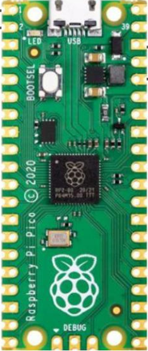
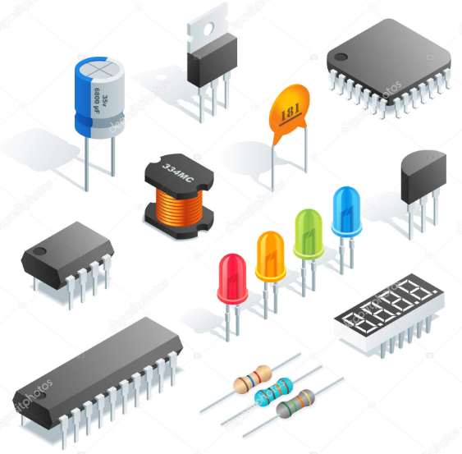
PicoGenius.com
Pico Pi
Electronics

Slide 2



Slide 3
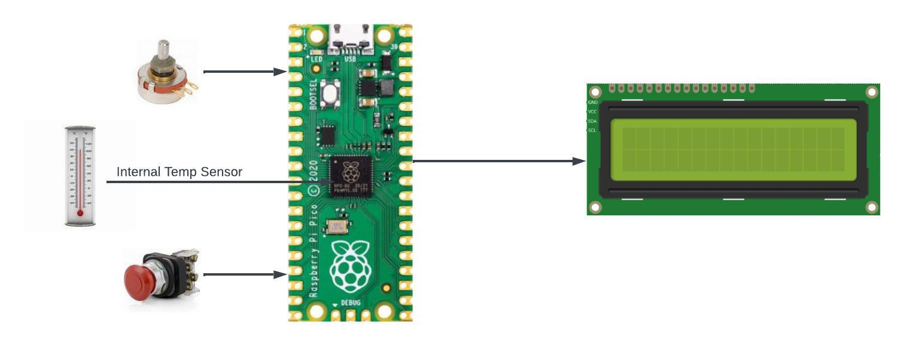

Slide 4
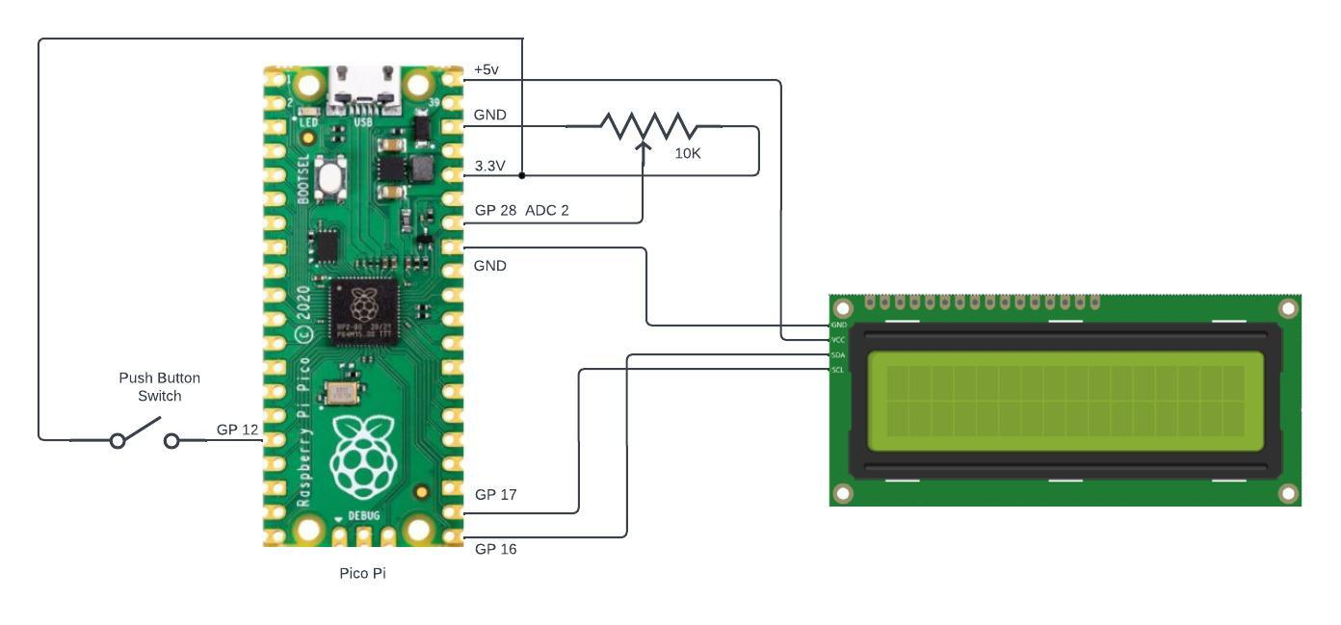

Slide 5
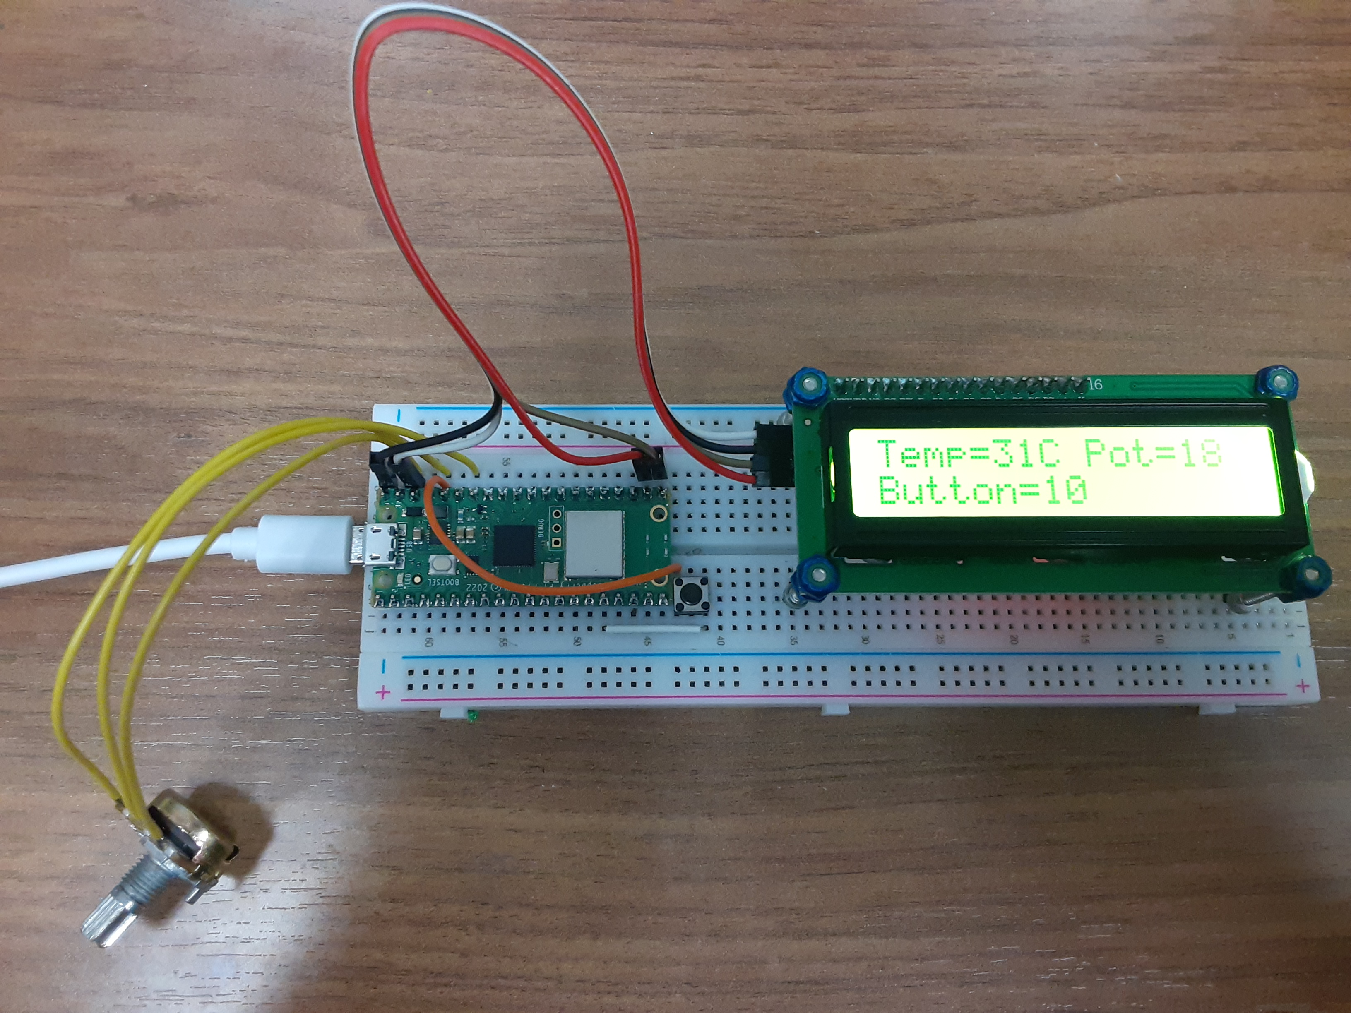

Slide 6
"""
This program reads the value of the PI's on-board temperature sensor, an externally connect pot, and a push button
and processes these values and writes these values to a 16X2 LCD display
"""
from machine import I2C, ADC, Pin
from time import sleep
from pico_i2c_lcd import I2cLcd
i2c = I2C(0, sda=Pin(16), scl=Pin(17), freq=400000) #i2c connection to Pi
temp_sensor = ADC(4) # Default connection of temperature sensor
pot1 = machine.ADC(28) #Analog input connection to Pi
button1 = Pin(12,Pin.IN,Pin.PULL_DOWN) #GPIO connection to Pi
I2C_ADDR = i2c.scan()[0]
lcd = I2cLcd(i2c, I2C_ADDR, 2, 16)
lcd.backlight_on()
def temperatureC():
# get raw sensor data
raw_sensor_data = temp_sensor.read_u16()
# convert raw value to equivalent voltage
sensor_voltage = (raw_sensor_data / 65535)*3.3
# convert voltage to temperature (celcius)
temperatureC = 27 - (sensor_voltage - 0.706)/0.001721
return temperatureC
while True:
tempC = int(temperatureC())
tempF = int(tempC*1.8+32)
pot2 = pot1.read_u16() #read the pot value
pot2 = int(pot2/1300) #scale the pot value between 0 and 50
if pot2 <= 1:
pot2 = int(1) #Keep the pot value positive
button = int(10)
if not button1.value(): #if the push button is not pressed
button = int(10) # 'button' is 10. If the push button
if button1.value(): # is pressed 'button' is 20
button = int(20)
lcd.putstr("Temp="+str(tempC)+"C ") #send variables to the
lcd.putstr("Pot="+str(pot2)+"\n") #LCD display
lcd.putstr("Button="+str(button))
sleep(1)
lcd.clear() #Clear the display

Slide 7
"""
This program reads the value of the PI's on-board temperature sensor, an externally connect pot, and a push button
and processes these values and writes these values to a 16X2 LCD display
"""
from machine import I2C, ADC, Pin
from time import sleep
from pico_i2c_lcd import I2cLcd
i2c = I2C(0, sda=Pin(16), scl=Pin(17), freq=400000) #i2c connection to Pi
temp_sensor = ADC(4) # Default connection of temperature sensor
pot1 = machine.ADC(28) #Analog input connection to Pi
button1 = Pin(12,Pin.IN,Pin.PULL_DOWN) #GPIO connection to Pi
I2C_ADDR = i2c.scan()[0]
lcd = I2cLcd(i2c, I2C_ADDR, 2, 16)
lcd.backlight_on()
def temperatureC():
# get raw sensor data
raw_sensor_data = temp_sensor.read_u16()
# convert raw value to equivalent voltage
sensor_voltage = (raw_sensor_data / 65535)*3.3
# convert voltage to temperature (celcius)
temperatureC = 27 - (sensor_voltage - 0.706)/0.001721
return temperatureC
while True:
tempC = int(temperatureC())
tempF = int(tempC*1.8+32)
pot2 = pot1.read_u16() #read the pot value
pot2 = int(pot2/1300) #scale the pot value between 0 and 50
if pot2 <= 1:
pot2 = int(1) #Keep the pot value positive
button = int(10)
if not button1.value(): #if the push button is not pressed
button = int(10) # 'button' is 10. If the push button
if button1.value(): # is pressed 'button' is 20
button = int(20)
lcd.putstr("Temp="+str(tempC)+"C ") #send variables to the
lcd.putstr("Pot="+str(pot2)+"\n") #LCD display
lcd.putstr("Button="+str(button))
sleep(1)
lcd.clear() #Clear the display
Toms Hardware at
Tomshardware.com/how-to/lcd-display-raspberry-pi-pico
Pico_i2c_lcd.py
Lcd_api.py

Slide 8
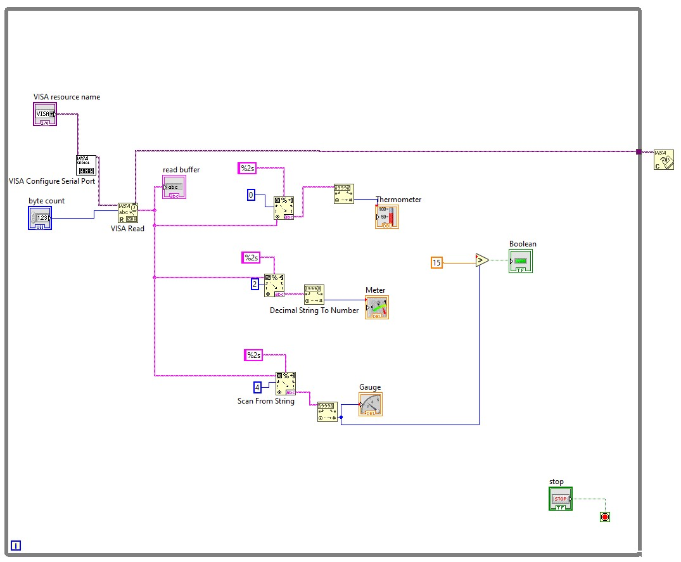
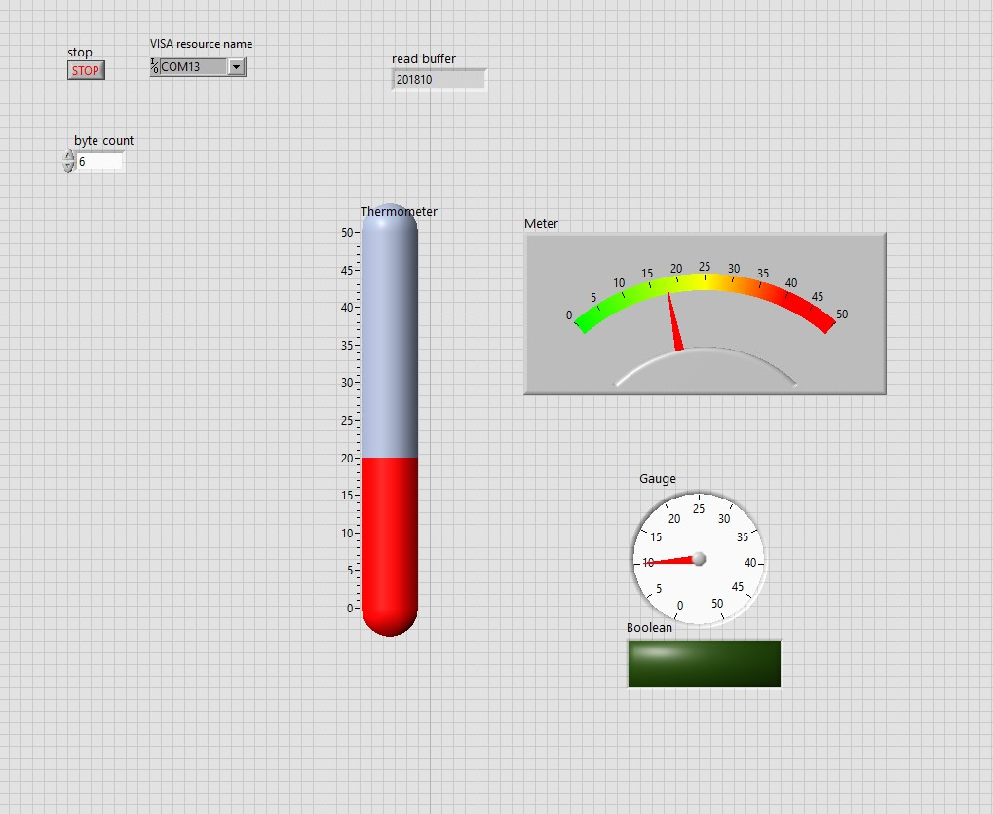

Slide 9
