Slide 1


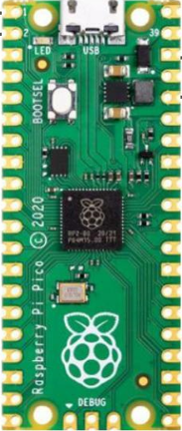
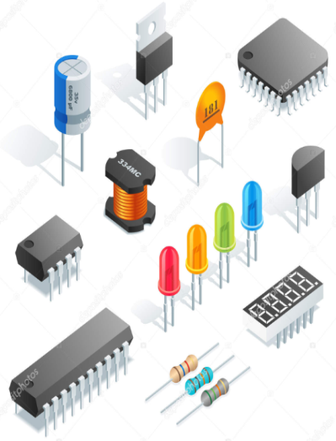
PicoGenius.com
Pico Pi
Electronics

Slide 2
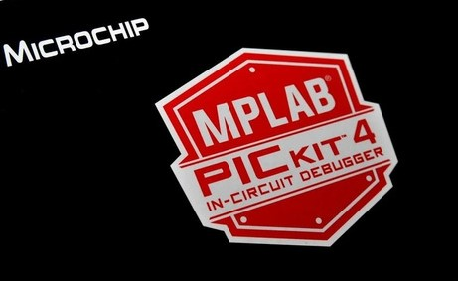
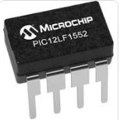

Slide 3
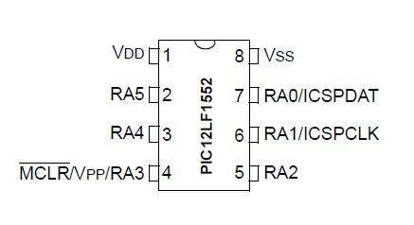
2048 bytes of Flash memory
128 bytes of RAM
Operates at frequencies up to 32 MHz
16-level deep hardware stack
49 instructions
10 general-purpose I/O pins
2 analog inputs
10-bit A/D converter
16-bit timer/counter
Real-time clock (RTC)
Brown-out reset (BOR)
Programmable voltage supervisor (PVD)
Low-power sleep mode
Clock-out pin
In-circuit serial programming (ICSP)

Slide 4
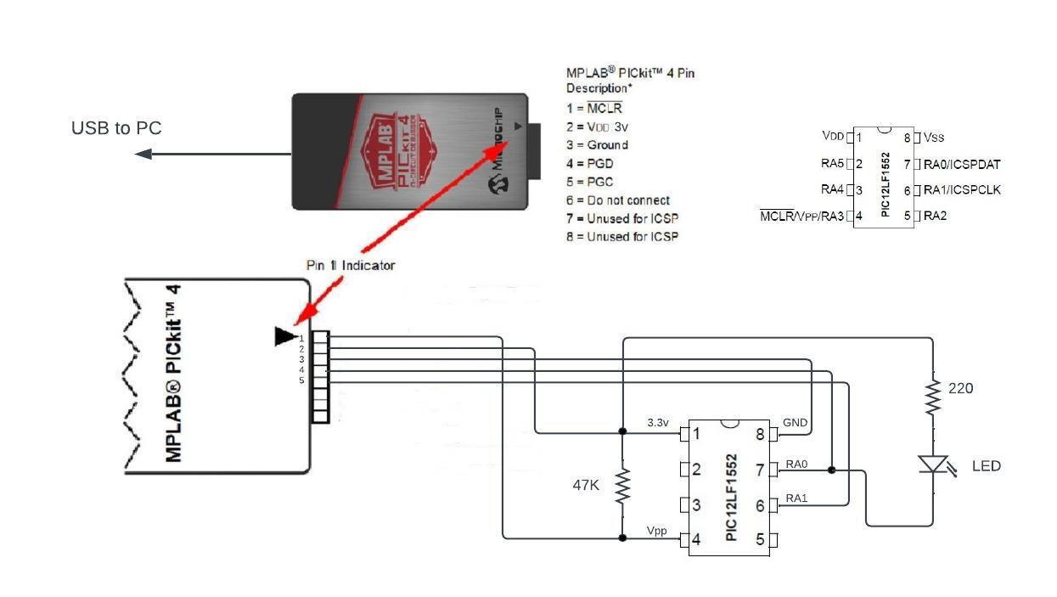

Slide 5
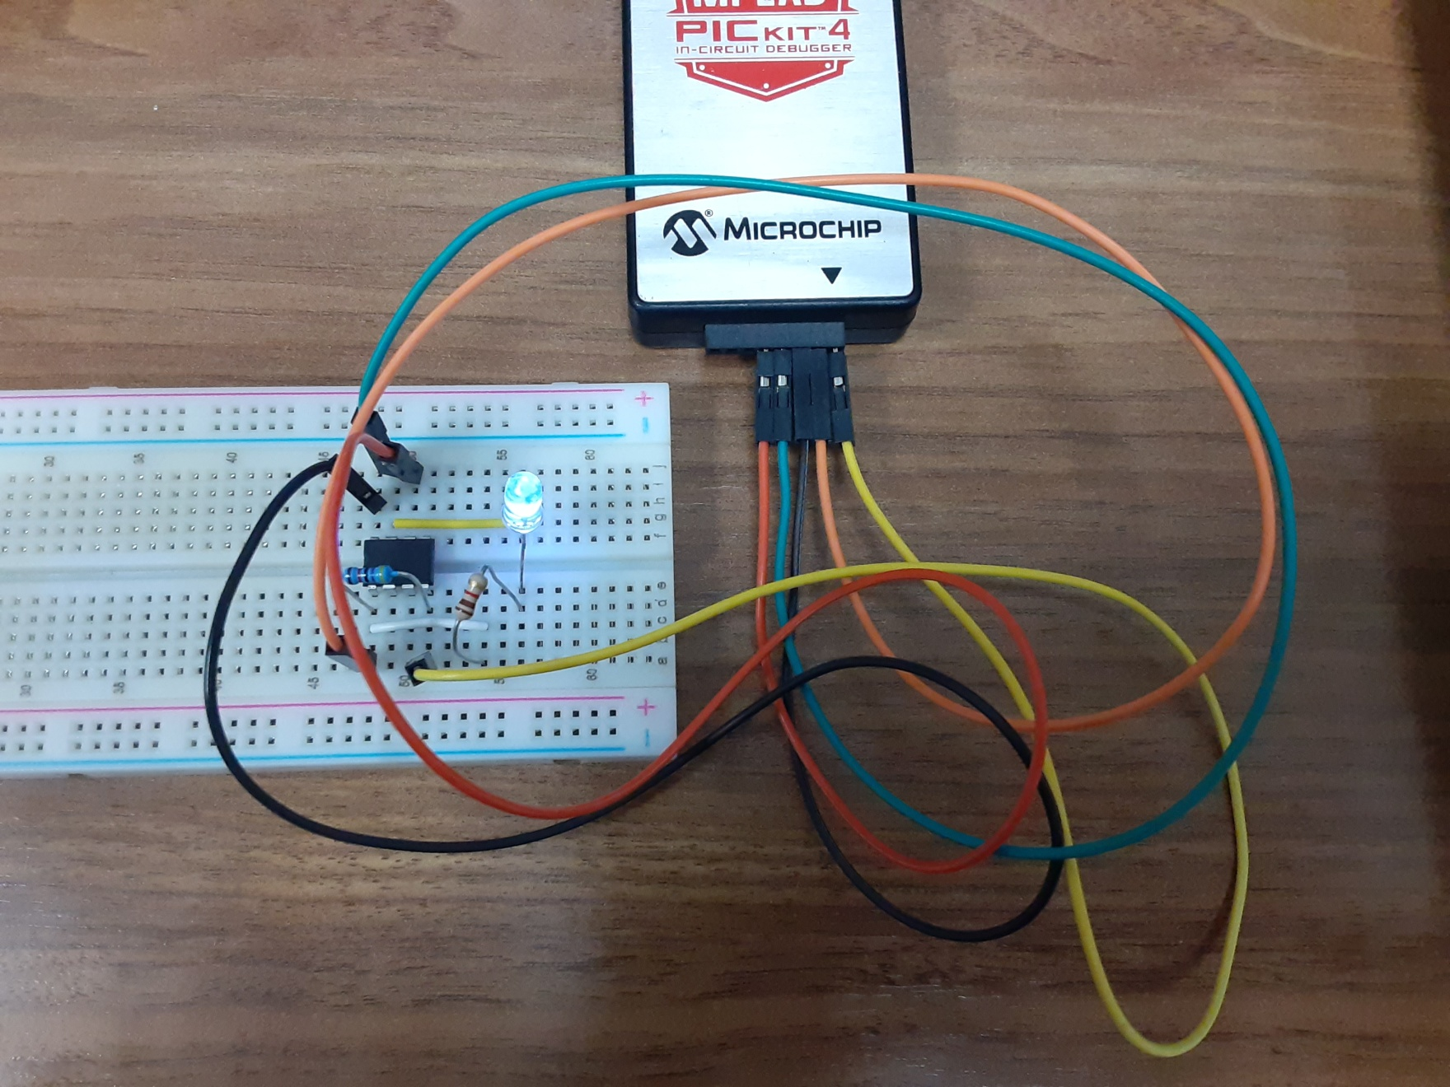

Slide 6


WWW.Microchip.com
Tools and Resources
Develop
Integrated
Development
Environment
C Compiler (XC8)
And
Assembler XC-AS

Slide 7
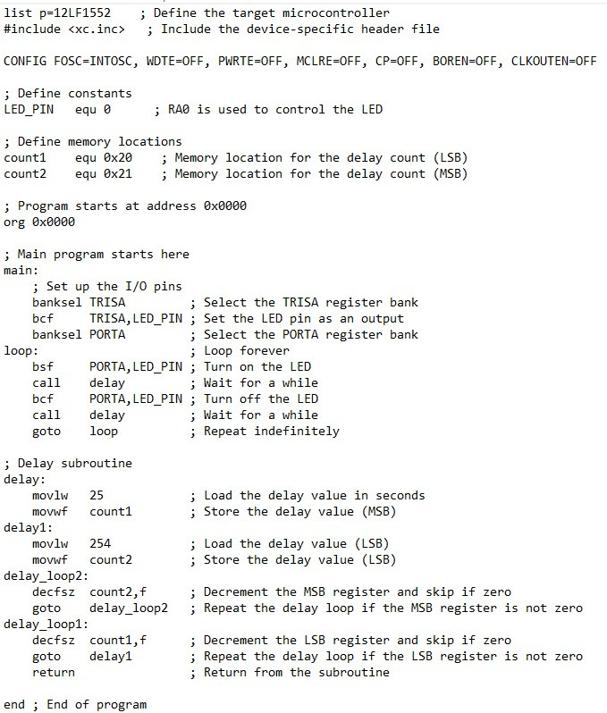
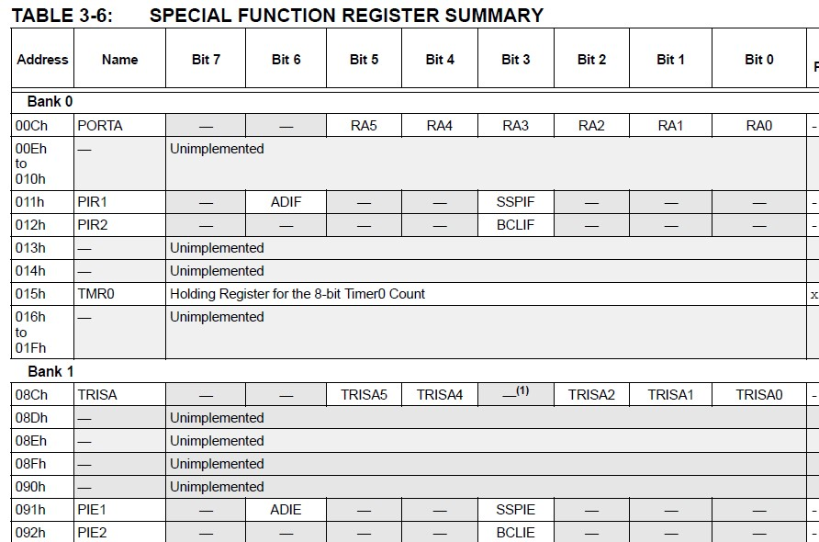

Slide 8
