Slide 1


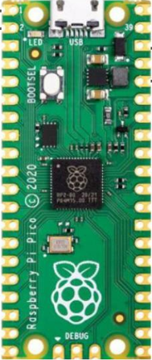

PicoGenius.com
Pico Pi
Electronics

Slide 2
Introduction: 24Cxx EEPROM interface to Pi Pico
Acknowledgements
Microchip 24Cxx EEPROMs
24C02 EEPROM interface to Pi Pico Schematic
Photo of 24Cxx EPROM interface to Pi Pico
Pi Pico
Python code for the 24C02 EPROM interface to Pi Pico
Using Pi Pico with Thonny
Simple Logic analyzer with Saleae Software
Using a logic analyzer
I2C interface

Slide 3
Acknoledgements
I2C Reference:
Paeag Shah
I2C Video 1
I2C Video 1
I2C Video 1
Microchip 24Cxx Reference:
Shiva siddharth
24Cxx Library Reference:
Mike Causer
Return

Slide 4
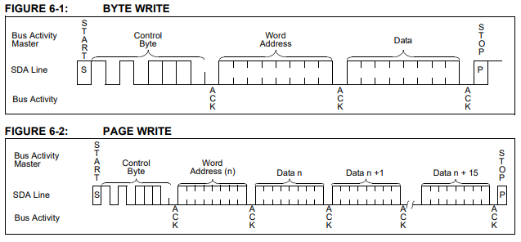
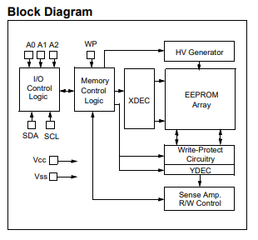
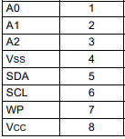
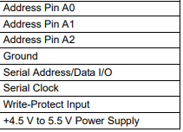
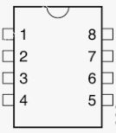
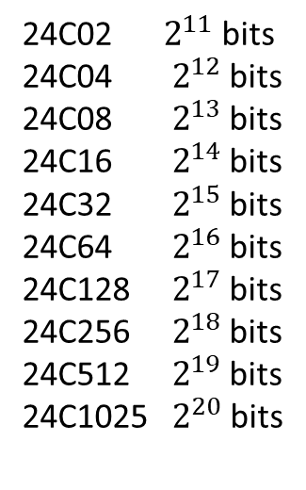
Microchip 24CXXX EEPROM Memory
24C02 $2^{11}$ bits
24C04 $2^{12}$ bits
24C08 $2^{13}$ bits
24C16 $2^{14}$ bits
24C32 $2^{15}$ bits
24C64 $2^{16}$ bits
24C128 $2^{17}$ bits
24C256 $2^{18}$ bits
24C512 $2^{19}$ bits
24C1025 $2^{20}$ bits
Number following the ‘C’
Represents Kbits of
Memory storage (base 2)
Bytes of storage =Kbits/8
E.g. 24C02 2048/8=32 bytes
Return

Slide 5
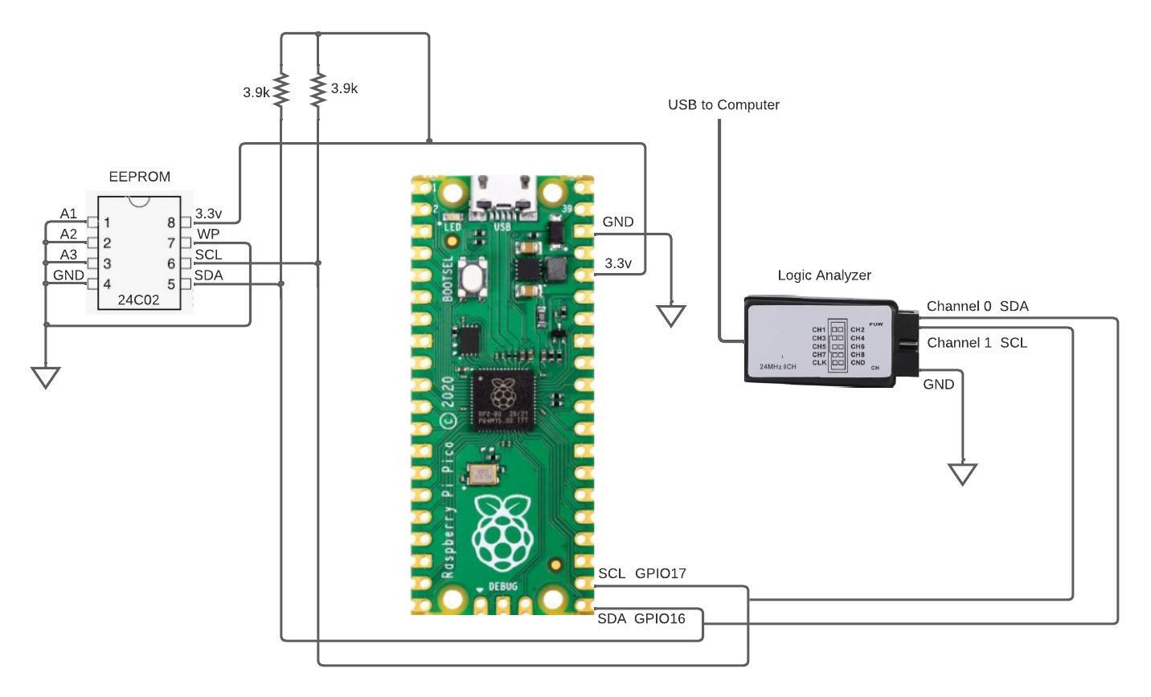
Return

Slide 6
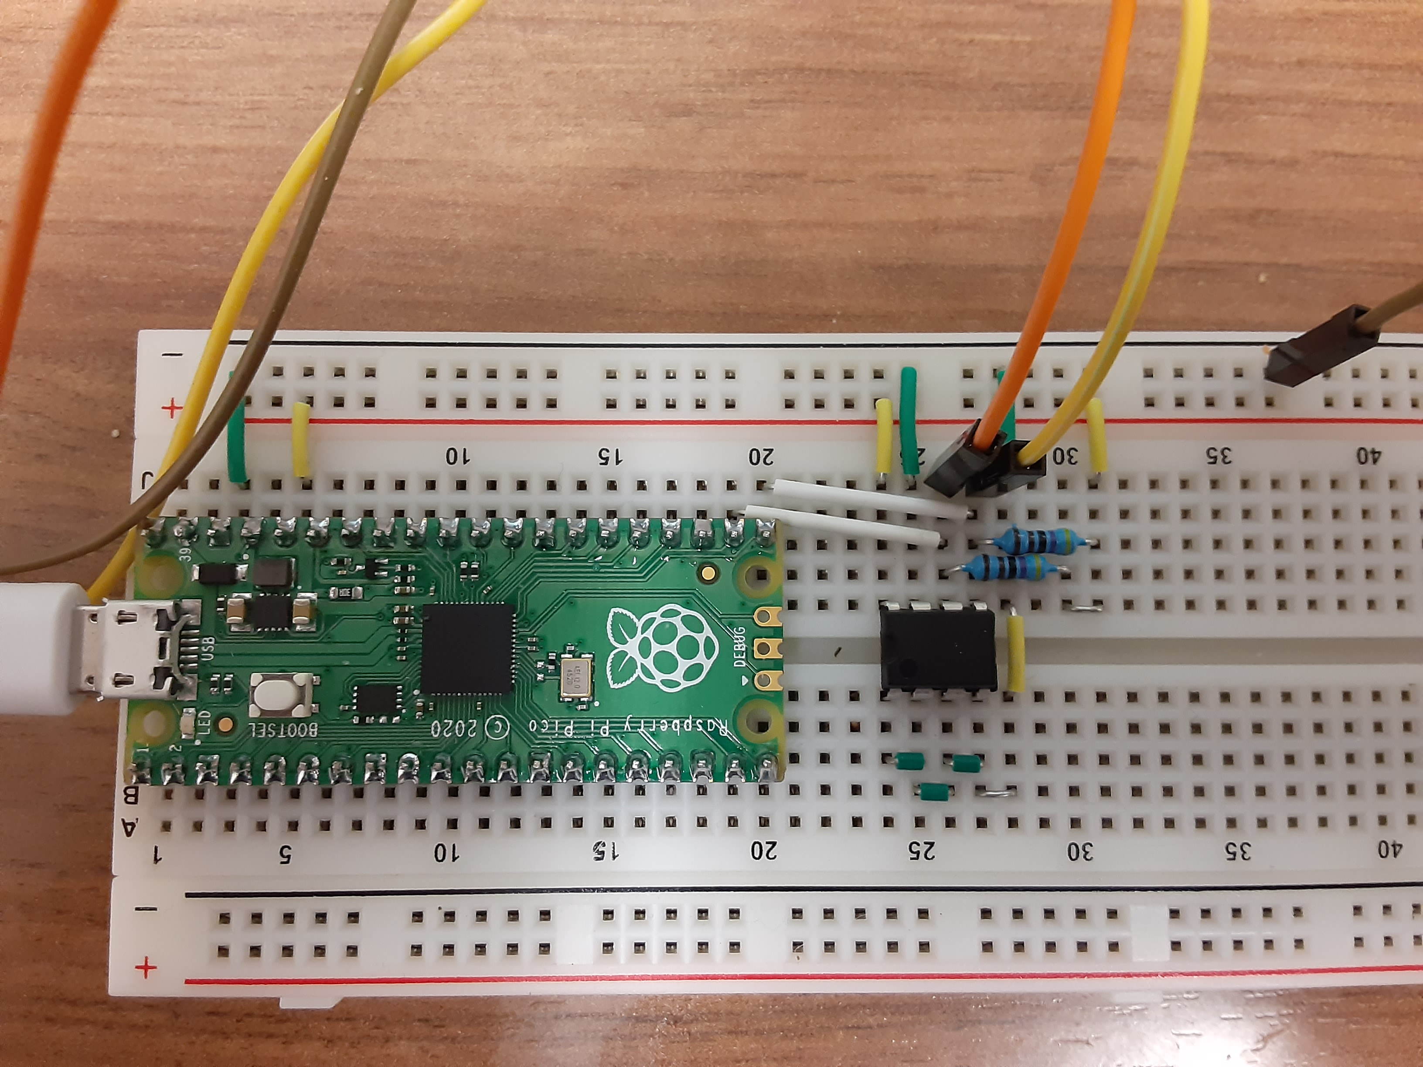
Return

Slide 7
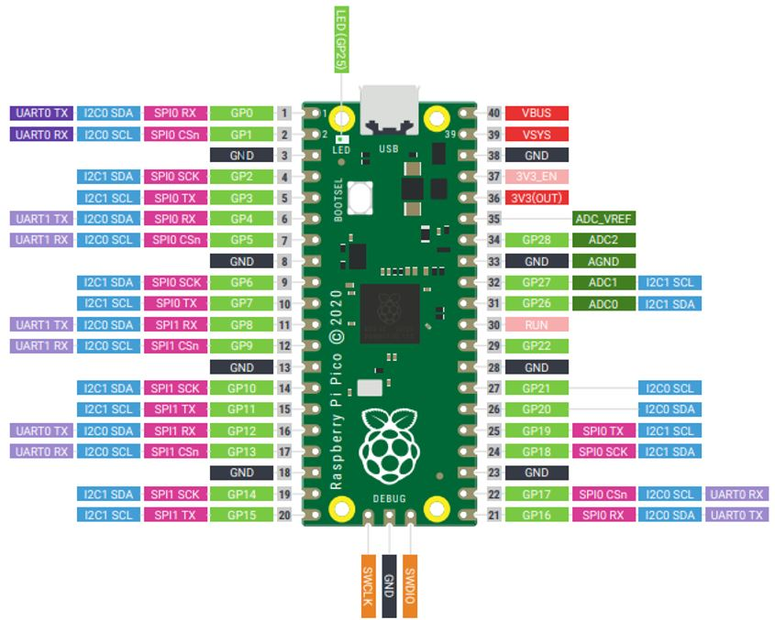
Return

Slide 8
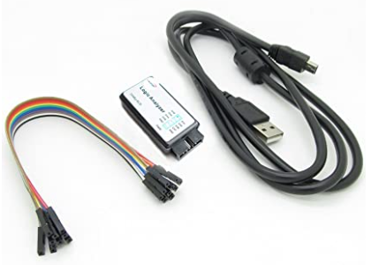
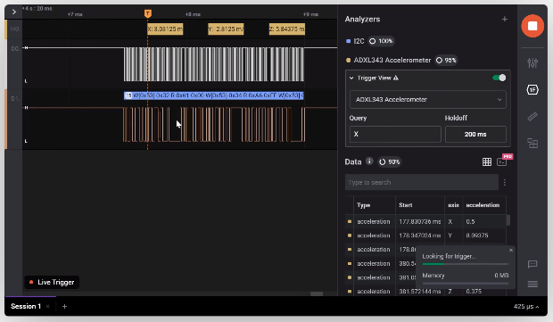
Logic Analyzer Hardware from Amazon
Link to Hardware
Logic Analyzer Software from Saleae
Link to software
Users Guide
Return

Slide 9
from machine import I2C, Pin
import time
####################################################################
#This is a class called CAT24C02, which is a library for
#interacting with a CAT24C02 EEPROM chip using the I2C protocol.
####################################################################
class CAT24C02(object):
def __init__(self, i2c, i2c_addr, pages=2, bpp=16):
self.i2c = i2c
self.i2c_addr = i2c_addr
self.pages = pages
self.bpp = bpp # bytes per page
def capacity(self):
"""Storage capacity in bytes"""
return self.pages * self.bpp
def read(self, addr, nbytes):
"""Read one or more bytes from the EEPROM starting from a specific address"""
return self.i2c.readfrom_mem(self.i2c_addr, addr, nbytes, addrsize=8)
def write(self, addr, buf):
"""Write one or more bytes to the EEPROM starting from a specific address"""
offset = addr % self.bpp
partial = 0
# partial page write
if offset > 0:
partial = self.bpp - offset
self.i2c.writeto_mem(self.i2c_addr, addr, buf[0:partial], addrsize=8)
time.sleep_ms(5)
addr += partial
# full page write
for i in range(partial, len(buf), self.bpp):
self.i2c.writeto_mem(self.i2c_addr, addr+i-partial, buf[i:i+self.bpp], addrsize=8)
time.sleep_ms(5)
def wipe(self):
buf = b'\xff' * 32
for i in range(1):
self.write(i*32, buf)
#this is the main program following the CAT24C02 class
sda=machine.Pin(0)
scl=machine.Pin(1)
i2c=machine.I2C(0,sda=sda, scl=scl, freq=400000)
i2caddr=80 #Set the I2C address of your EEPROM.
eeprom = CAT24C02(i2c,i2caddr) #create an instance of the class
#######################################
#Read and Write routines for the 24C02
#######################################
#eeprom.write(0, b'0123456789BCDEF0123456789abcdef') # Write String to memory address 0
eeprom.write(0, 'Th') # Write String to memory address 0
#eeprom.write(0, b'00000000000000001111111111111111') # Mutliple page writes (fill pages 0 and 1 with test data)
#eeprom.write(13, b'abcdef') # Write is performed in two steps, "abc" in the first page then "def" in the next page
#eeprom.wipe() # Wipe the EEPROM
#print(eeprom.read(0,32)) #read the entire memory space (256 bits, 32 bytes)
print(eeprom.read(0,2)) #Read one byte
#print((eeprom.read(0, 32)).decode('utf-8')) #Read and print 32Bytes as a string starting from memory address 0
#print((eeprom.read(0, 10)).decode('ascii'))

Slide 10
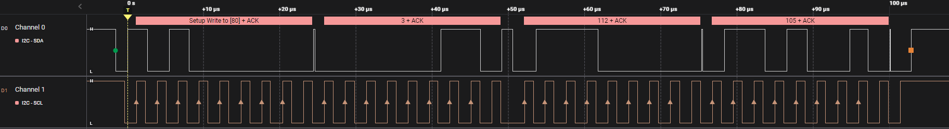
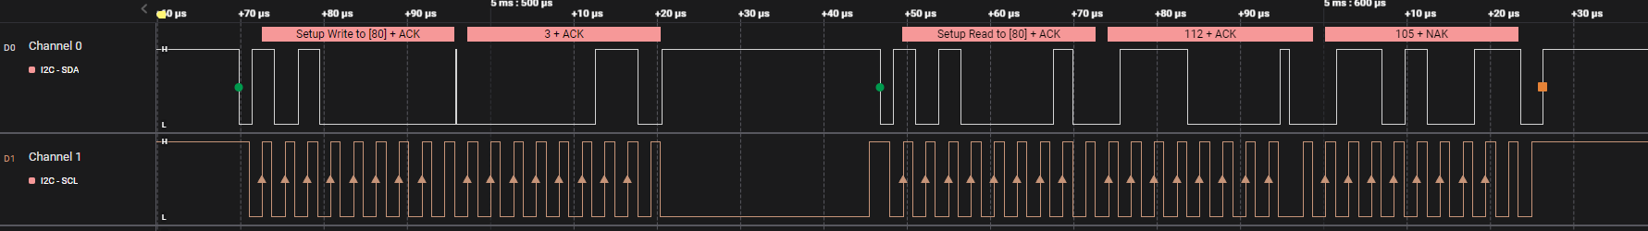
Write
70H - p
69H - i
1
0
1
0
0
0
0
0
0
0
0
0
0
0
0
1
1
0
0
1
1
1
0
0
0
0
0
0
1
1
0
1
0
0
1
0
Start
Write Low
ACK
ACK
ACK
ACK
Stop
Read
70H - p
69H - i
1
0
1
0
0
0
0
0
0
0
0
0
0
0
0
1
1
0
1
0
1
0
0
0
0
1
0
0
1
1
1
0
0
0
0
0
0
1
1
0
1
0
0
1
1
Start
Write Low
ACK
ACK
Read Hi
ACK
ACK
NAK
Stop
Return
NAK Sent by master indicating no more data requested

Slide 11
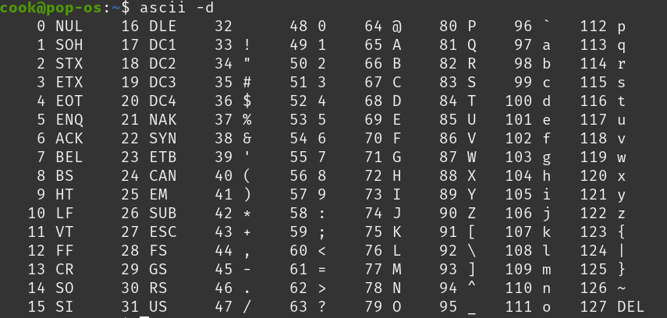


Return

